Slide 1
Early Care and Education: Survey of Mississippi Issues Impacting Children (MIIC)
Forum for the Future-----January 12, 2021
Linda H. Southward, Ph.D.
Executive Director

Slide 3
UCLA writing workshop: 3 ?
Topic
Topic
Topic
What do you know about ______?
What do you know, feel, believe, think about ________?
What do I still want to know? Repeat, repeat, repeat

Slide 4
Goals for Today’s Presentation
Provide
Share
IMPROVE
&
ENCOURAGE
general information about children in Mississippi
(Mississippi Issues Impacting Children) survey results from Mississippians on what they think about children’s issues
critical thinking about how this research can inform evidence- based action on behalf of children in Mississippi

Slide 5
Mississippi is a State Full of Children!!!
Each day, approximately 100 babies are born in Mississippi.
Nearly one in four Mississippians are children
Among all children in MS, one in four are young children
51% of children under age 5 in MS are children of color
Among Mississippians:
706,141 children (0-18 years)
188,000 young children (0-4 years)
38,000 4-year-olds

Slide 6
Demographics of Our Children
Among MS children, 78% live in households headed by their parent(s), while 18% live in households headed by their grandparents. 44% of MS children live in households with a single parent.
In 2019, 28% of MS children were living in poverty(100% FPL) and 12% of MS children were living in extreme poverty (50% FPL)
Poverty differences by racial make-up
Of MS children under age six who are African American, 43% are living in poverty. Among Non-Hispanic White children under six, 14% are living in poverty.
Source: AECF KidsCount, ACS Table C17001

Slide 7
Pre-K in Mississippi
The State of Mississippi funds Pre-K opportunities for approximately 9 percent of our four-year-olds through the Pre-K Collaboratives (pre-COVID 19)
Approximately 38,000 total four-year-olds
Approximately 3,000+ Pre-K seats
In 2020, the Mississippi legislature is to be commended in “raising the rate” to more adequately reimburse for the costs associated per child

Slide 8
Distribution of MS Child Care Centers
Prior to COVID-19:
1,475 total licensed centers open
Source: Mississippi State Department of Health

Slide 9
Survey methodology overview
Findings presented are taken from a statewide telephone survey of Mississippi residents, aged 18 years or older
collected using probability sampling techniques and
weighted according to US Census Bureau population parameters
Survey was conducted in August of 2019 by Social Science Research Center, Mississippi State University
Final dataset n = 410
The survey was supported by a grant from the W.K. Kellogg Foundation and commissioned by the Children’s Foundation of Mississippi .

Slide 10
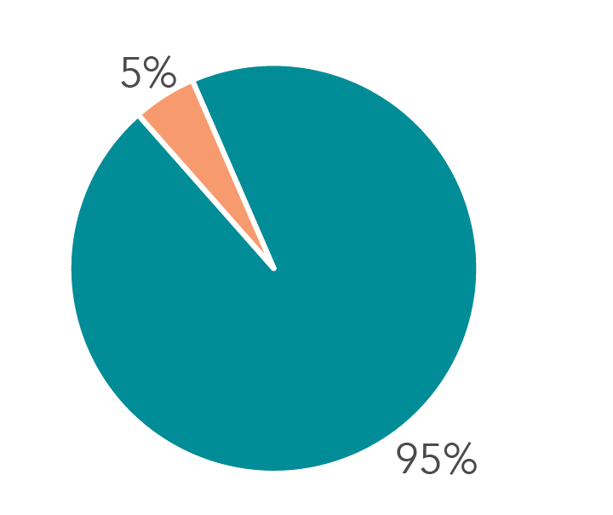
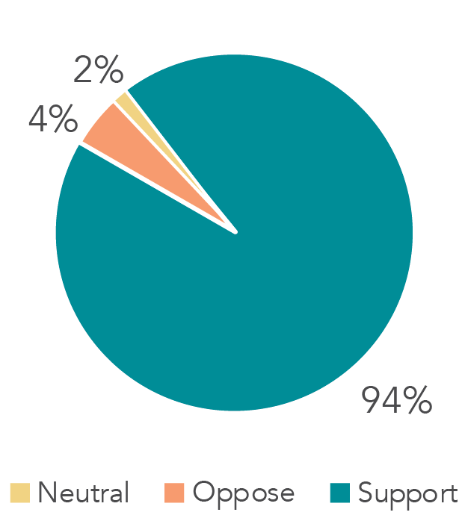
Findings indicate broad, general population support for childcare measures among Mississippians
Support of a quality rating scale for child care
Support of well-child checks prior to childcare and/or pre-K enrollment
Support for state funded Pre-Kindergarten

Slide 11
Strong General Population of Mississippians Support for Public Pre-K
Among general population samples, support for public pre-kindergarten has remained high in Mississippi over time
2007: 83% support “state-funded public pre-kindergarten”
2010: 71% support the state “improv[ing] early learning opportunities”
2019: 83% support “state-funded public pre-kindergarten”
Source: Survey of Mississippi Issues Impacting Children (2019), Mississippi Center for Education Innovation (2010); Mississippi Kids Count (2007)

Slide 12
Additional Survey findings: Meeting Families’ Basic Needs
Reported Satisfaction with ____ options in own community

Slide 13
Implications of Research/Next steps
Use of data as a “tool” to
Learn
Adapt
Improve
Junious Williams—Mississippi Thrive! Collective Impact Seminar 12.07.2020
Continue to elevate civic engagement on the importance of investments in quality childcare and positive outcomes for children

Slide 14
Data: Research as a “Tool”
Learn
Adapt
Improve
&
Encourage
Lead with the data—always! Yes, qualitative and quantitative and disaggregate as available.
Once we know what the data is, then adapt our practices, our programs, our child care quality, our number of Pre-K slots, etc can all be improved
Critical thinking about how this research can inform evidence- based to improve action on behalf of children in Mississippi

Slide 15
INSERT VIDEO

Slide 16
Contact Information
linda@childrensfoundationms.org
Linda H. Southward, Ph.D.
Executive Director, Children’s Foundation of Mississippi

